Slide 1
Muscle Training in the Acute Phase of
I 、Ⅱ Subacromial Impingement Syndrome
Song Jing
Yi Lingrong
Huang Mengdan
Liu Zefan

Slide 2
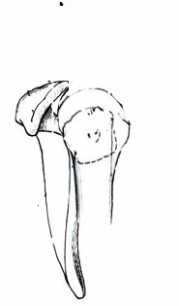
1
Brief Introduction about SAIS

Slide 3
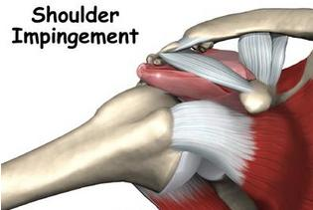
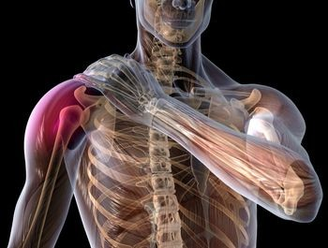
Typical syndromes
painful feeling as the shoulder abduces or elevates to a certain degree or position

Slide 4
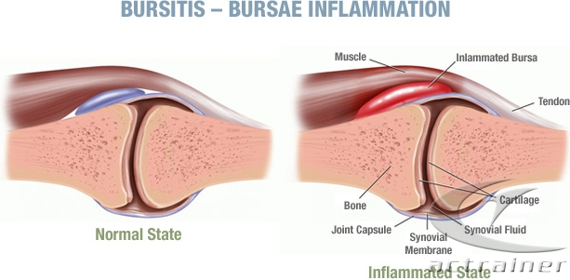
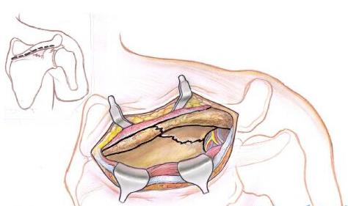
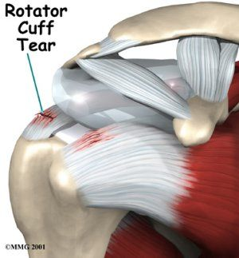
SAIS
1
Osteophyma come into being
2
Synovial bursa becomes inflamed
3
Rotator cuff is impaired

Slide 5
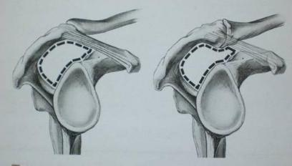
Repetitive elevation at the shoulder
Hemorrhage,
edema and the congestion and inflammation of bursa
Reasons
the change of the shoulder structure

Slide 6
1
painful
2
project into your arm
Impacts
3
worsen at night
4
constrain the range of
your movements at the advanced stage

Slide 7
2
Techniques to Maintain Integrity and Function for Humeral Head Control

Slide 8
Multiple-Angle Isometrics
The biceps brachii
Supraspinatus
Infraspinatus
Teres minor
subscapularis
Self-Applied Multiple-Angle Isometrics

Slide 9
1
Patient position: supine sitting standing
2
Gentle resistance and pain-free posture
3
Apply resistance to the distal forearm
4
Talk with the patient
5
Apply resistance slowly

Slide 10
External rotation
Apply resistance against the dorsal surface of the forearm.
1
3
Position the humerus at the patient’s side.
Infraspinatus,
Teres minor,
Posterior deltoid
2
The elbow flexes 90°.

Slide 11
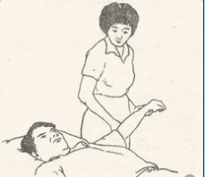
Abduction
Deltoid, supraspinatus, the long head of biceps brachii.
1
2
Resist abduction at 0°,30°,45°,and 60°.
Maintain the humerus neutral to rotation.

Slide 12
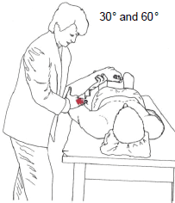
Scapular plane elevation
1
2
Position the shoulder between 30°and 60°of elevation.
Controlled manual resistance is applied to humerus.

Slide 13
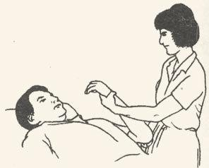
Elbow flexion with forearm supination.
The long head of biceps brachii.
1
3
Position the humerus at the side and neutral to rotation.
Change the position of the shoulder.
4
2
Repeat the isometric resistance to elbow flexion.
Apply resistance to forearm flexion.

Slide 14
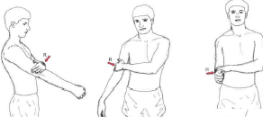
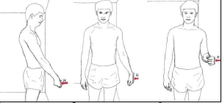
Self-Applied Multiple-Angle Isometrics
Using the opposite hand
Using a stationary object

Slide 15
3
Maintain Integrity and Stabilizing Function For Scapular Control

Slide 16
NOTE
Isometric exercises
Begin with the right position.
At an proper intensity.

Slide 17
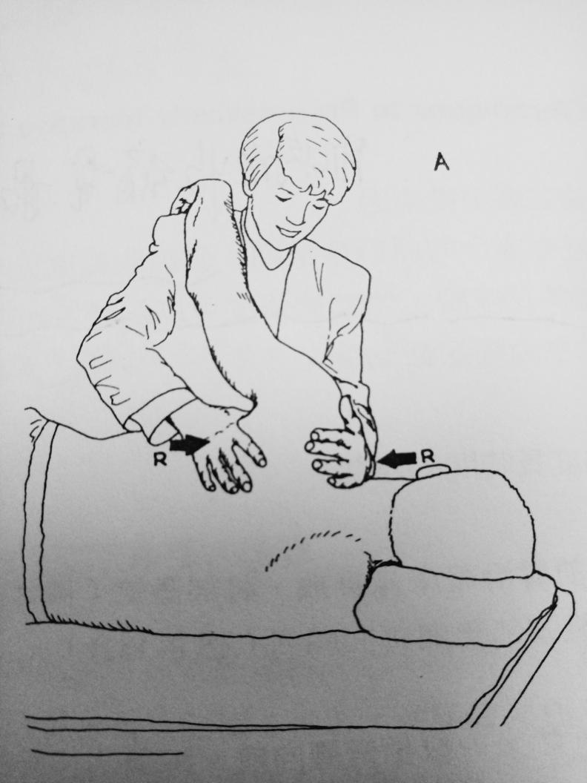
Elevation/Depression
Place top hand superiorly to resist elevation;the other hand against the inferior angle to resist depression;
Activation of the upper trapezius and levator scapulae muscle（elevation)and the lower trapezius(depression).

Slide 18
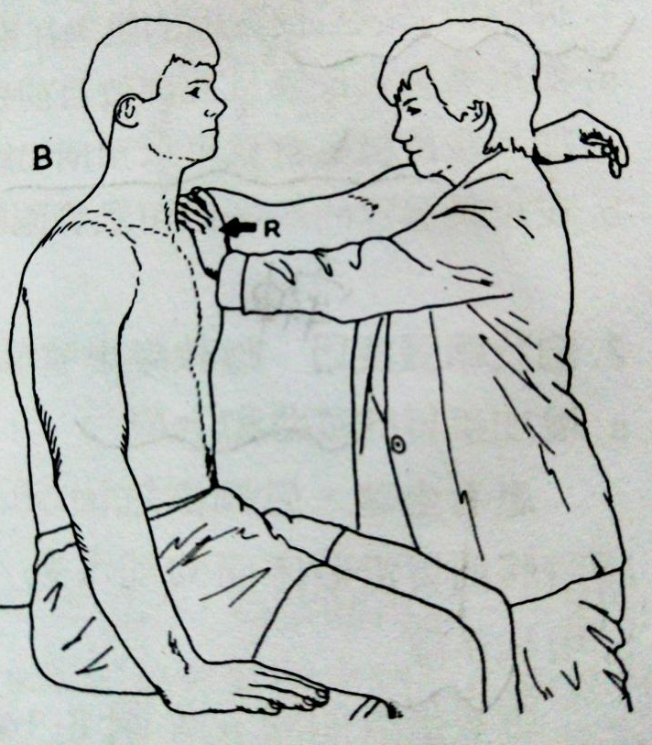
Protraction/Retraction
resist against the coracoid and acromion prosess;other hand is placed against the medial border.
Activation of the serratus anterior(protraction) and rhomboids and trapezius(retraction）.

Slide 19
Upward and downward rotation
Place one hand around the inferior angle and the other hand around the acromion and coracoid process to provide resistance.

Slide 20
Reference：
1.Carolyn Kisner,Lynn Allen Colby,Therapeutic Exercise Foundations and Techniques,six edition.
2.Cole BJ, Elattrache NS, Anbari A. Arthroscopic rotator cuff repairs: An anatomic and biomechanical rationale for different suture-anchor repair configuration[J]. Arthroscopy, 2007, 23(6):662-669.
3.Labriola JE, Lee TQ, Debski RE, et al. Stability and instability of the glenohumeral joint: The role of shoulder muscles[J]. J Shoulder Elbow Surg, 2005, 14(1 Suppl 1):S32-S38.
4.Kuhn JE． Exercise in the treatment of rotator cuff impingement: Asystematic review and a synthesized evidence － based rehabilitation protocol［J］． J Shoulder Elbow Surg，2009，18
( 1) : 138 ～ 160．
5.杜欢． 保守治疗肩峰下撞击综合征 30 例［J］． 南京中医药大学学报，2011，27( 5) : 487 ～ 488．
6.崔卫国，张志刚，陈德生．
肩峰下撞击综合征的治疗进展［J］．中国骨肿瘤骨病，2011，10( 4) : 397 ～ 401

Slide 21
THANK
YOU !!!

